Slide 1
Python Flow Control
Python if...else
Python for Loop
Python while Loop
Python break and continue
Python Pass
Python assert
Python return

Slide 2
Python if...else
What are if statement in Python?
Python if Statement Syntax
Python if Statement Flowchart
Example: Python if Statement
Python if...else Statement
Syntax of if...else
Python if..else Flowchart
Example of if...else
Python if...elif...else Statement
Syntax of if...elif...else
Flowchart of if...elif...else
Example of if...elif...else
Python Nested if statements

Slide 3
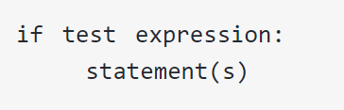
Python if Statement Syntax
Syntax

Slide 4
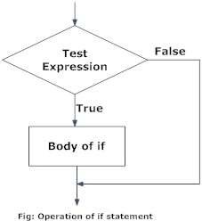
Python if Statement Flowchart

Slide 5
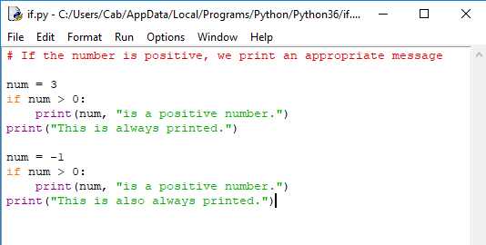
Example:

Slide 6
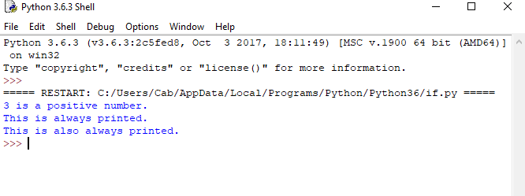
Output

Slide 7
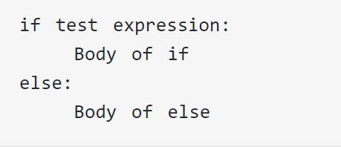
Syntax of if...else
Syntax

Slide 8
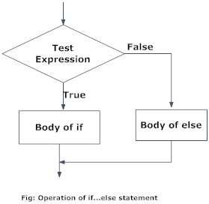
Python if..else Flowchart

Slide 9
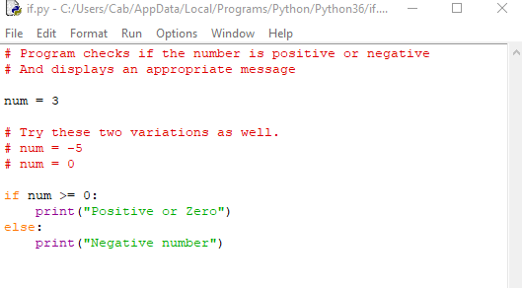
Example of if...else

Slide 10
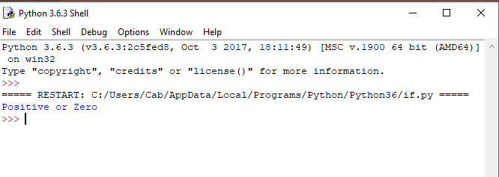
Output

Slide 11
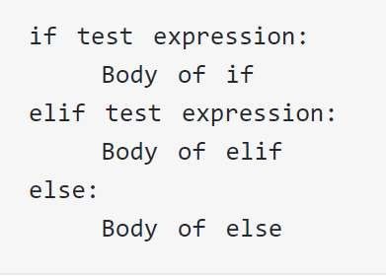
Syntax of if...elif...else
Syntax

Slide 12
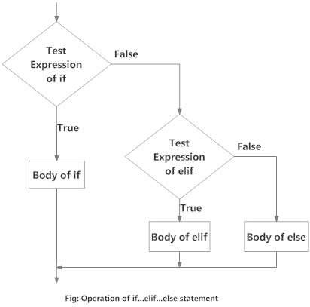
Flowchart of if...elif...else

Slide 13
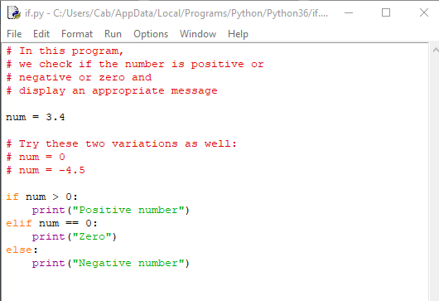
Example of if...elif...else

Slide 14
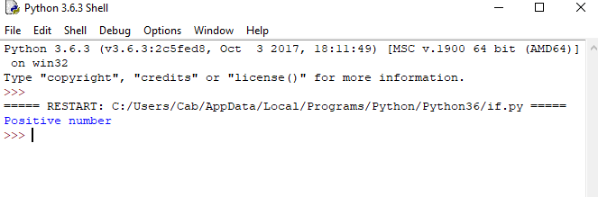
Output

Slide 15
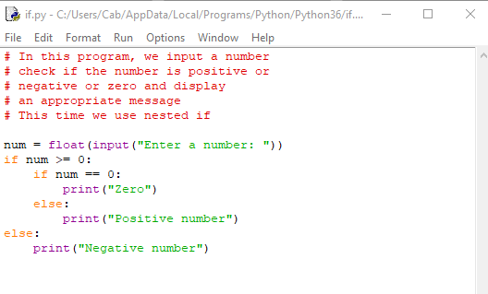
Python Nested if statements

Slide 16
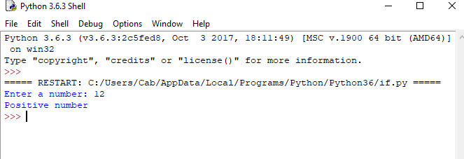
Output

Slide 17
Python for Loop
What is for loop in Python?
Syntax of for Loop
Flowchart of for loop
Example: Python for Loop
The range() function
for loop with else

Slide 18
What is for loop in Python?
Is used to iterate over a sequence (list, tuple, string) or other iterable objects
Iterating over a sequence is called traversal

Slide 19
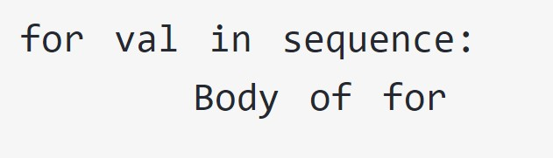
Syntax of for Loop:
Here, val is the variable that takes the value of the item inside the sequence on each iteration
Loop continues until we reach the last item in the sequence.
The body of for loop is separated from the rest of the code using indentation.

Slide 20
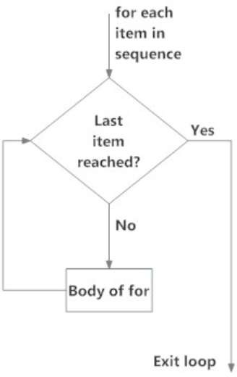
Flowchart of for Loop

Slide 21
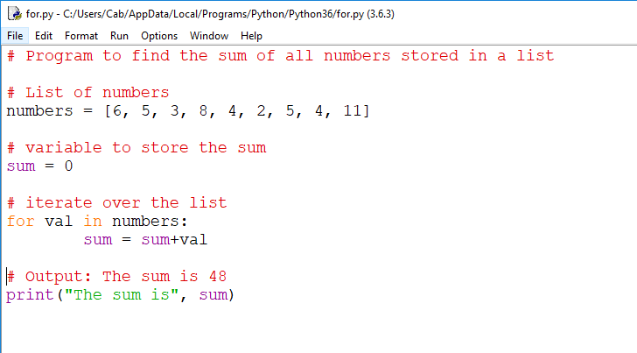
Example

Slide 22
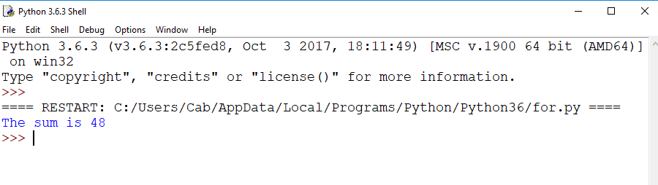

Slide 23
The range() function
Can generate a sequence of numbers using range() function
range(10) will generate numbers from 0 to 9 (10 numbers)
Can also define the start, stop and step size as range(start,stop,stepsize)
Step size defaults to 1 if not provided.
Does not store all the values in memory, it would be inefficient
So it remembers the start, stop, step size and generates the next number on the go

Slide 24
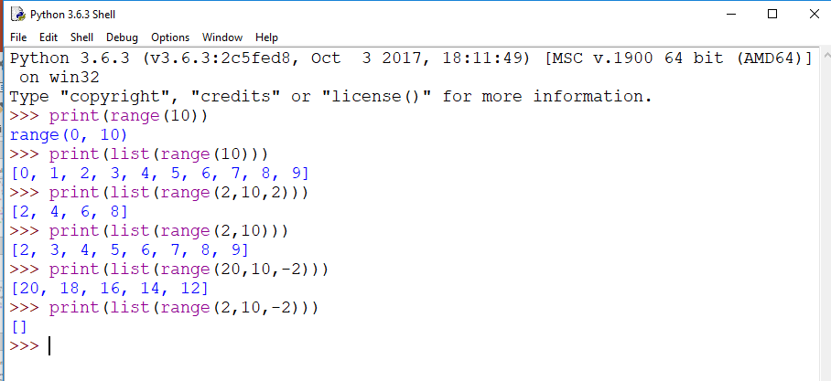
Example

Slide 25
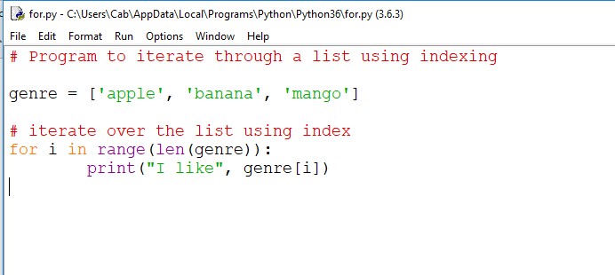
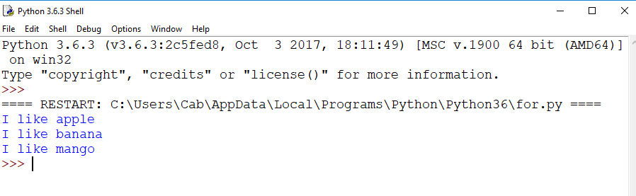

Slide 26
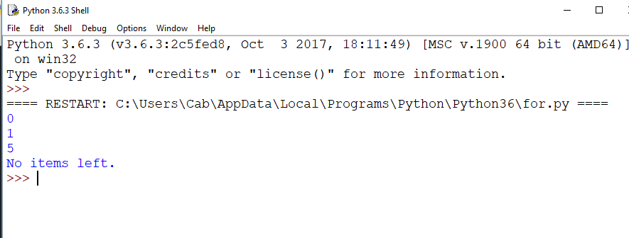
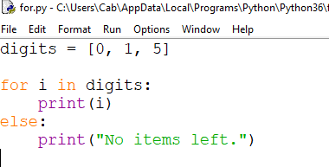
for loop with else

Slide 27
Python while Loop
What is while loop in Python?
Syntax of while Loop in Python
Flowchart of while loop
Example: Python while Loop
while loop with else

Slide 28
What is while loop in Python?
Is used to iterate over a block of code as long as the test expression (condition) is true
Generally this loop is used when we don't know beforehand, the number of times to iterate

Slide 29
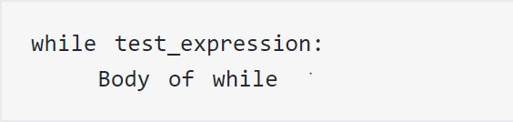
Syntax of while Loop in Python
Python interprets any non-zero value as True. None and 0 are interpreted as False.

Slide 30
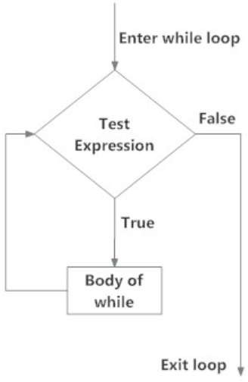
Flowchart of while Loop

Slide 31
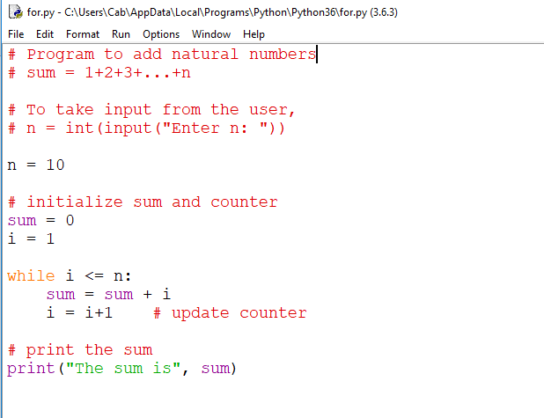
Example

Slide 32
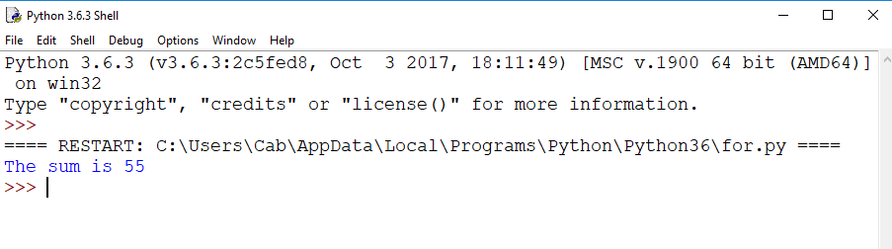

Slide 33
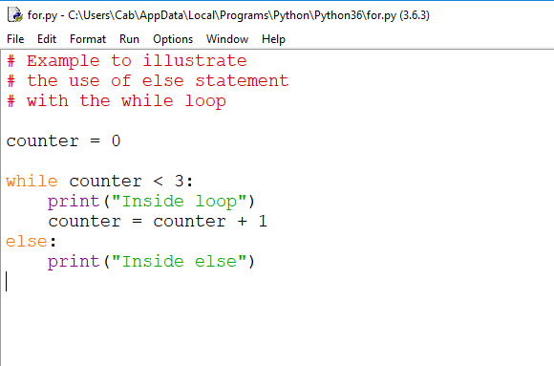
while loop with else

Slide 34
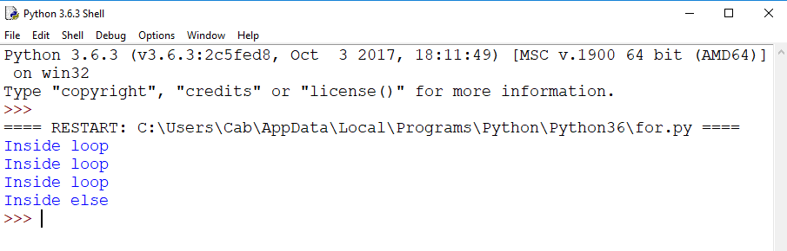

Slide 35
Python break and continue
What is the use of break and continue in Python?
Python break statement
Syntax of break
Flowchart of break
Example of break
Python continue statement
Syntax of Continue
Flowchart of continue
Example: Python continue

Slide 36
What is the use of break and continue in Python?
break and continue statements can alter the flow of a normal loop
Loops iterate over a block of code until test expression is false, but sometimes we wish to terminate the current iteration or even the whole loop without checking test expression
break and continue statements are used in these cases

Slide 37

Python break statement
Terminates the loop containing it
Control of the program flows to the statement immediately after the body of the loop.
If break statement is inside a nested loop (loop inside another loop), break will terminate the innermost loop
Syntax of break

Slide 38
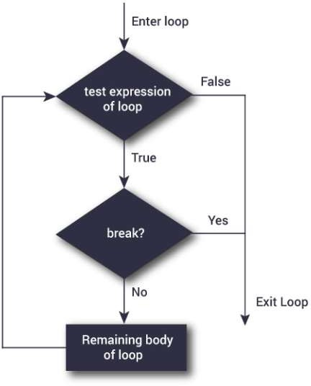
Flowchart of break

Slide 39
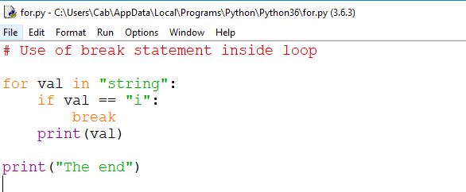
Example

Slide 40
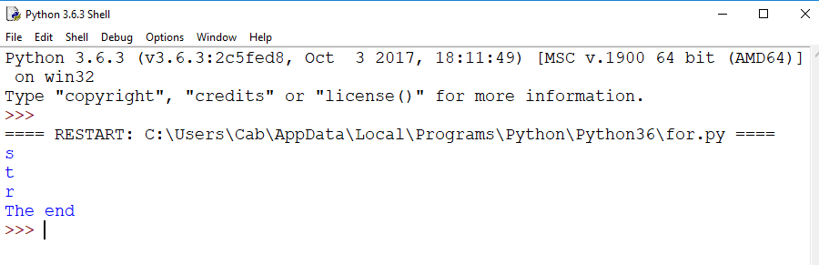

Slide 41

Python continue statement
Is used to skip the rest of the code inside a loop for the current iteration only
Loop does not terminate but continues on with the next iteration
Syntax of Continue

Slide 42
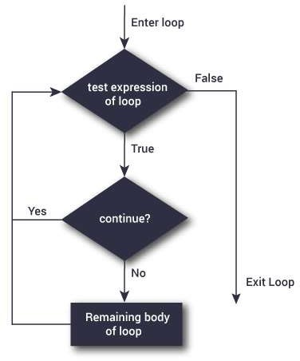
Flowchart of continue

Slide 43
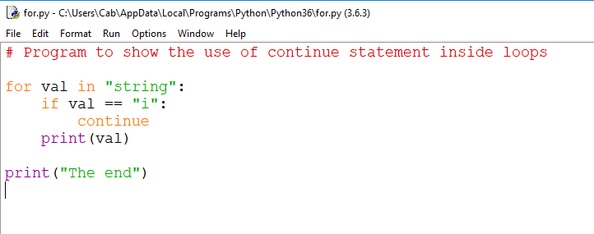
Example

Slide 44
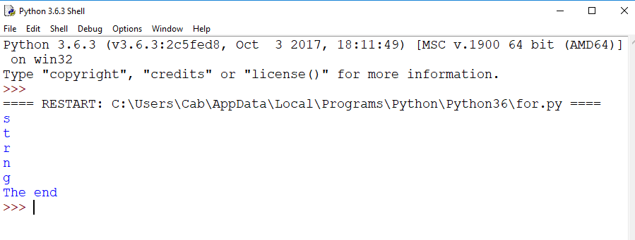

Slide 45
Python pass statement
What is pass statement in Python?
Syntax of pass
Example: pass Statement

Slide 46

What is pass statement in Python?
pass is a null statement
The difference between a comment and pass statement in Python is that, while the interpreter ignores a comment entirely, pass is not ignored
However, nothing happens when pass is executed
It results into no operation (NOP)
Syntax of pass

Slide 47
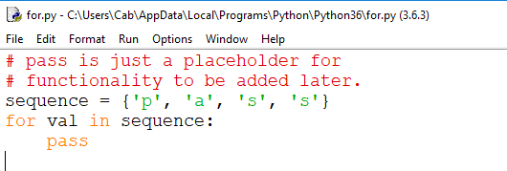
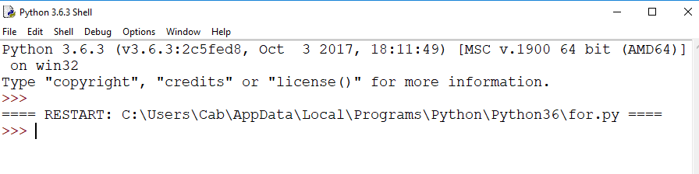
Example

Slide 48
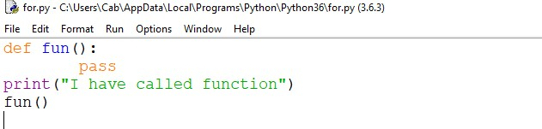
Example

Slide 49
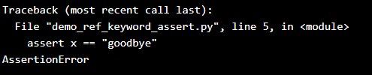
Python assert keyword
Definition and Usage
The assert keyword is used when debugging code.
The assert keyword lets you test if a condition in your code returns True, if not, the program will raise an AssertionError.
Example
Test if a condition returns True:
x = "hello" #if condition returns True, then nothing happens: assert x == "hello" #if condition returns False, AssertionError is raised: assert x == "goodbye"

Slide 50
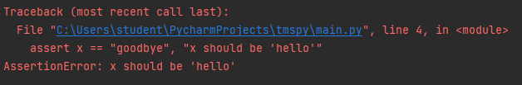
Python assert keyword
You can write a message to be written if the code returns False, check the example below.
x = "hello"
#if condition returns False, AssertionError is raised:
assert x == "goodbye", "x should be 'hello'"

Slide 51
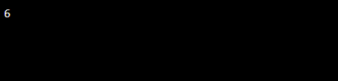
Python return keyword
Definition and Usage
The return keyword is to exit a function and return a value.
Example
Exit a function and return the sum:
def myfunction(): return 3+3 print(myfunction())

Slide 52
Python return keyword
Example
Statements after the return line will not be executed:
def myfunction(): return 3+3
print(“Kongu College”) print(myfunction())

